Slide 1





Data Science and Artificial Intelligence (EE0005)
PANDAS
Jain Shlok
(U1822687F)
Siddesh Sambasivam Suseela (U1822929B)

Slide 2

Dataset
What’s Cooking

Slide 3
Objective
To classify a given Recipe or Ingredient to their respective cuisines.

Slide 4
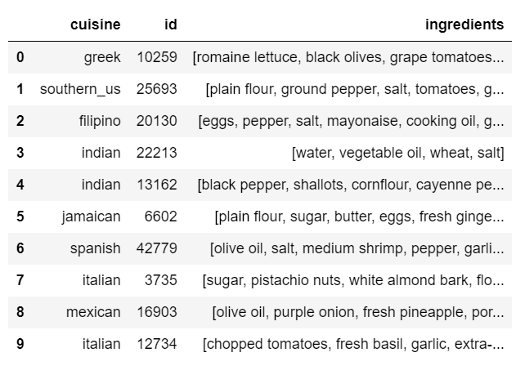
Data Analysis and Observations
Visualise the dataset

Slide 5
For your Information:
Recipe → [ ‘plain flour’ , ‘ground pepper’ , ‘salt’ , ‘tomatoes’ , ‘black pepper’ , ‘eggs’ ]
Ingredient → ‘salt’

Slide 6
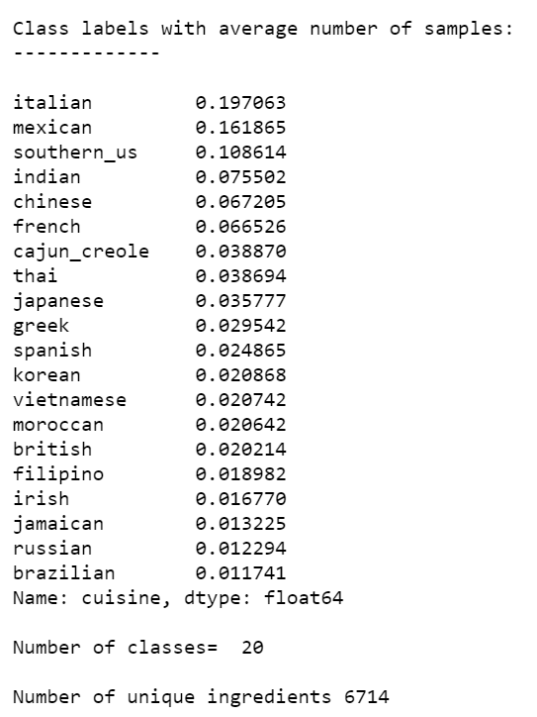
Different types of labels
Average number of samples in cuisines (Normalised Version)
Unique classes
Unique ingredients

Slide 7
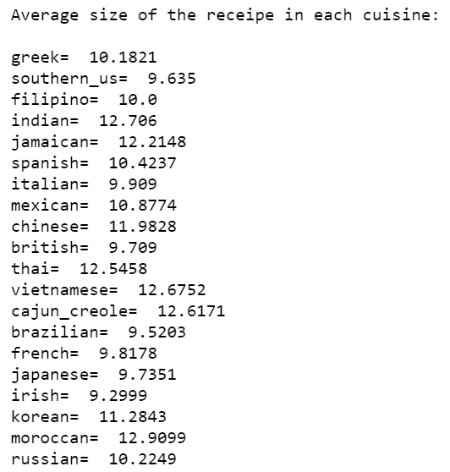
Average length of ingredients list

Slide 8
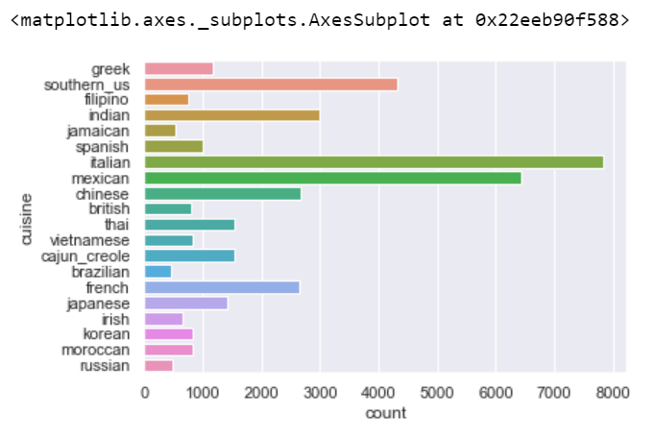
Data Visualisation (Count Plot)

Slide 9
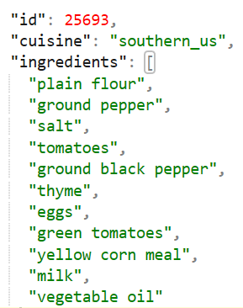
Text Pre-processing

Slide 10


ML Problem
Classifying text recipes into different cuisine
(Classification task)

Slide 11
How did we prepare the data for training?
Cuisine : indian, chinese. etc…
Recipe: “ plain flour ground pepper salt tomatoes ground black pepper thyme eggs green tomatoes yellow corn meal milk vegetable oil ”

Slide 12
Cuisine labels
Label Encoder
Cuisine values
Labels
eg:
['brazilian', 'british', 'russian', 'southern_us', 'spanish']
‘brazilian’ → [ 1 0 0 0 0 ]
'british' → [ 0 1 0 0 0 ]
:
:
:
:
:
:
:
:
:
:
:
:

Slide 13
Ingredients
Tokenizer
Padded Sequences
Text data
words → Tokens
String → Sequences
Padded
GloVe embeddings
eg:
“ plain flour ground pepper salt tomatoes ground black pepper thyme eggs green tomatoes yellow corn meal milk vegetable oil ”
[ [155], [233], [666], … [22] ] → [ [155], [233], [666]....[22]....[0],[0] ]

Slide 14
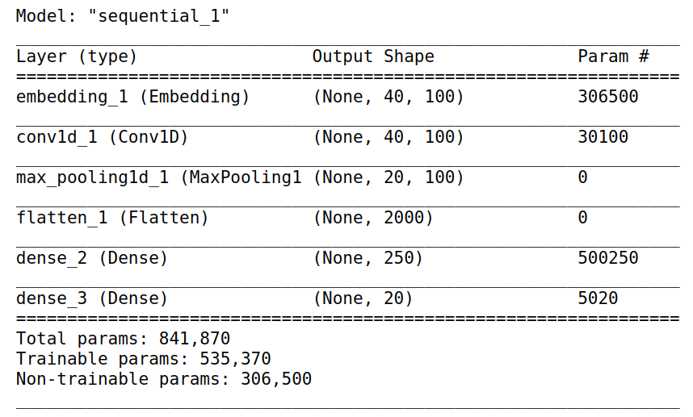
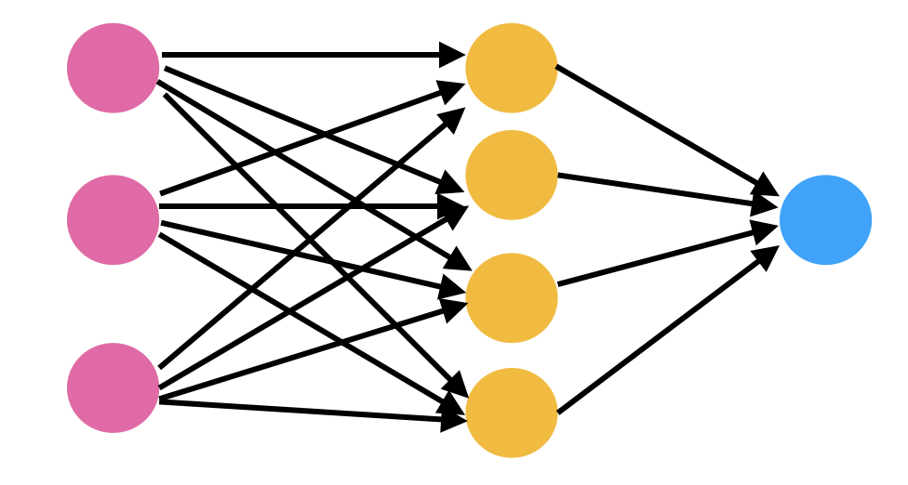
ML Solution : Neural networks

Slide 15
Jupyter Notebook

Slide 16
Token visualization

Slide 17
How did we apply ML technique to solve the problem
Which model?
Neural networks
Why?
Text data is an unstructured data and classical models are not effective with text data

Slide 18
Use of tools and techniques
Tensorflow → Keras
Sklearn → K-Fold cross-validation
Pandas → Handling data
Numpy → multi-tasks

Slide 19
Outcome
Accuracy: approx. 98 %
We are able to predict a cuisine to which a recipe belongs to.

Slide 20
Credits
Shlok- Data Preparation and Visualization
Siddesh- Machine Learning and Deep Learning

Slide 21

Thankyou!
Any questions?

